Slide 1
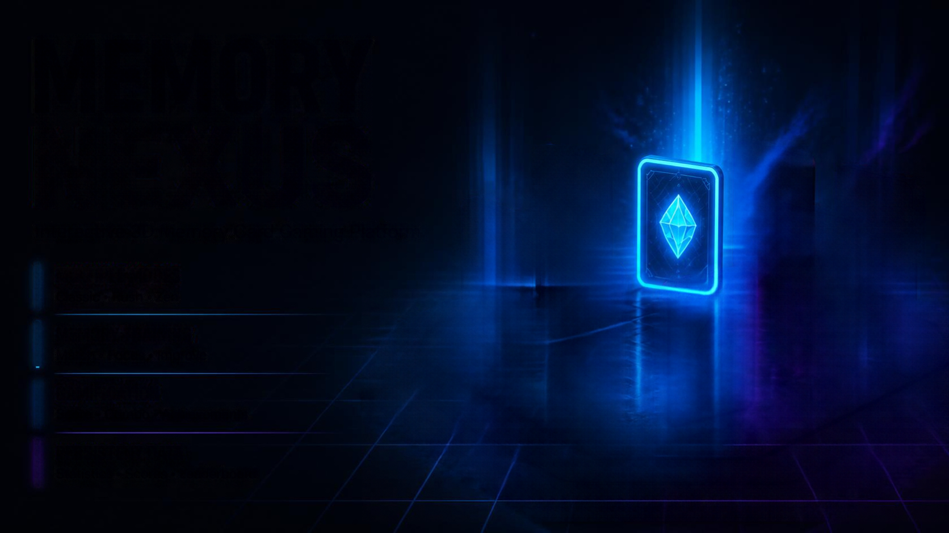
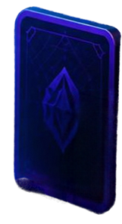
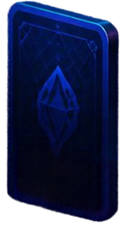
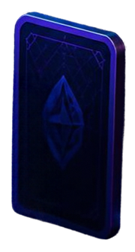
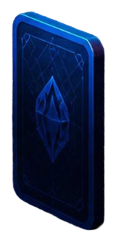
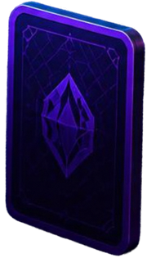
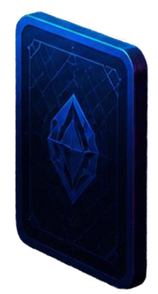
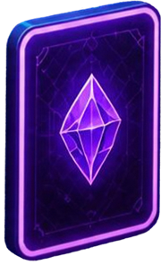
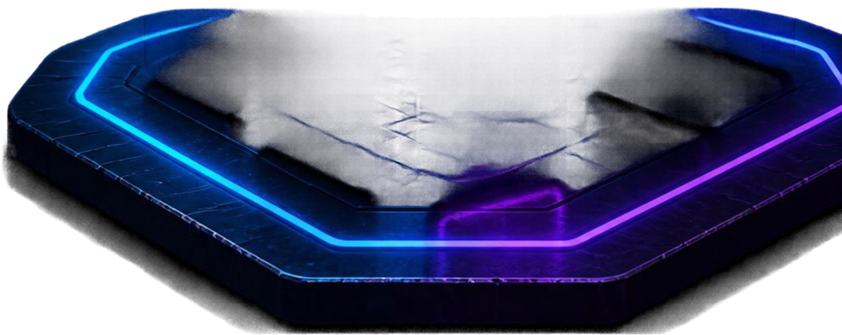
MEMORY
NEXUS
Interactive 3D Memory Card Gaming Platform
MULTIPLE MODES
Classic • Rush • Zen
MEMORY TRAINING
Match • Focus • Improve
GAMIFICATION
Score • Combo • Achievements
PERSISTENT DATA
Statistics • Scores • Leaderboard

Slide 2
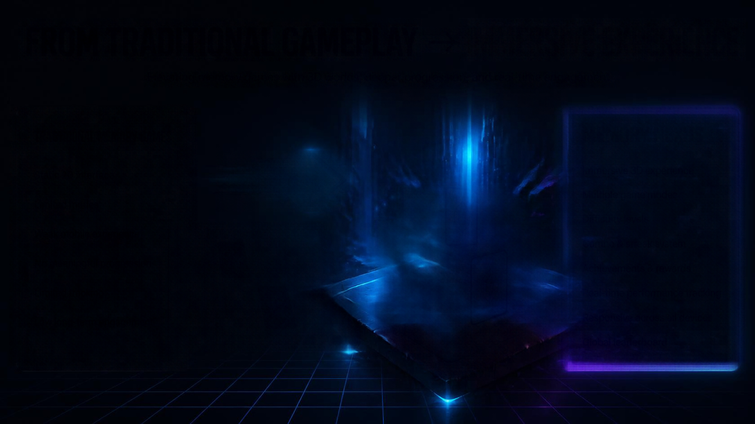

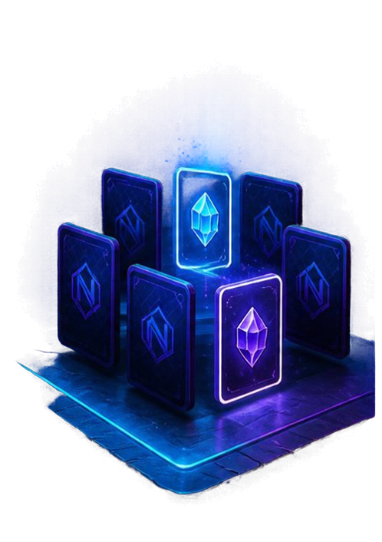












FROM TRADITIONAL GAMEPLAY
IMMERSIVE EXPERIENCE
Elevating memory games with 3D worlds, deeper progression, and real-time engagement.
TRADTIONAL MEMORY GAMES
MEMORY NEXUS
Static 2D interface
Immersive 3D experience
Multiple game modes
Limited modes
Difficulty levels
Weak mobile experience
Combo & streak system
No meaningful progression
Achievements & rewards
Limited tracking
Real-time performance tracking
Low long-term engagement
Responsive across all devices
Global leaderboard

Slide 3





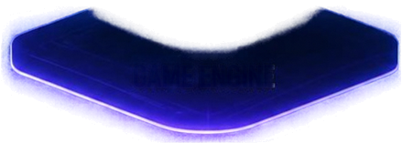

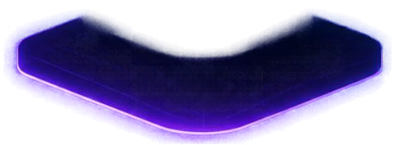

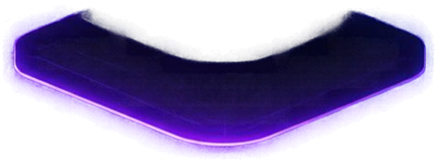

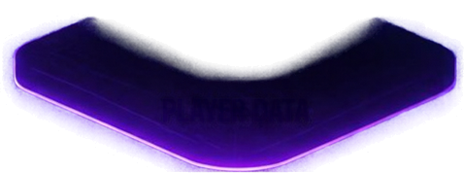

FULL-STACK
GAME ARCHITECTURE
Player
PLAYER
Seamless end-to-end platform
built for interactive 3D memory games
HTML5, CSS3,
JavaScript
RESPONSIVE FRONTEND
Modern web technologies for
responsive, engaging experiences
Responsive Design,
CSS 3D, Animations
GAME ENGINE
Node.js,
Express.js
Robust backend and lightweight
database for speed and reliability
BACKEND API
mongodb
Scalable foundation designed
for performance and growth
mongodb
Player Data
PLAYER DATA

Slide 4

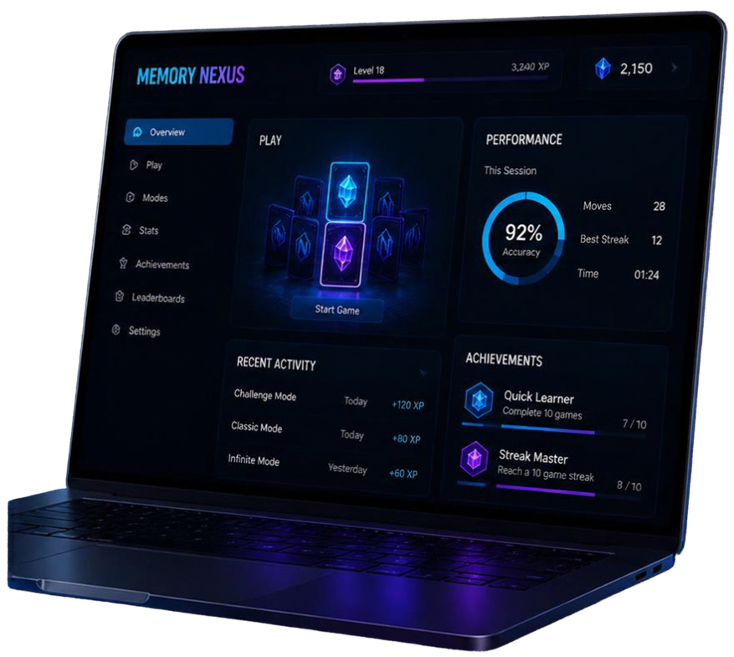
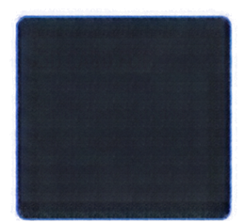


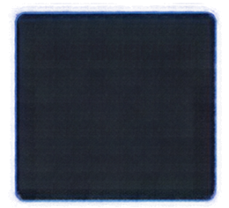
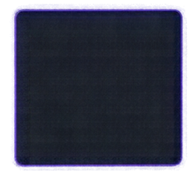

ENGINEERED FOR
ENGAGEMENT
Thoughtful mechanics. Intelligent design. Real results.
3D CARD FLIP
MULTIPLE MODES
DYNAMIC DIFFICULTY
Classic, Timed, Challenge, and Infinite for every play style.
4×4 • 4×6 • 6×6
Fluid animations and tactile feedback bring every move to life.
Progressive grids that adapt to your skill.
SMART GAMIFICATION
REAL-TIME PERFORMANCE
RESPONSIVE EXPERIENCE
Achievements, streaks, and rewards that keep you coming back.
Live stats and insights that help you improve every session.
Seamless across all devices with instant sync and save.

Slide 5















FROM MEMORY GAME TO
GAMING PLATFORM
Building the future of interactive memory gaming.
ENGAGEMENT
COGNITIVE
TRAINING
TECHNICAL
VALUE
SCALABILITY
Immersive gameplay that keeps players coming back.
Sharpen memory,
focus, and pattern recognition.
Real-time systems, analytics, and secure architecture.
Designed to grow
with a global player community.
05
01
02
03
04
MOBILE
APP
AUTHENTICATION
ONLINE
MULTIPLAYER
GLOBAL
LEADERBOARD
AI ADAPTIVE
DIFFICULTY

